Slide 1
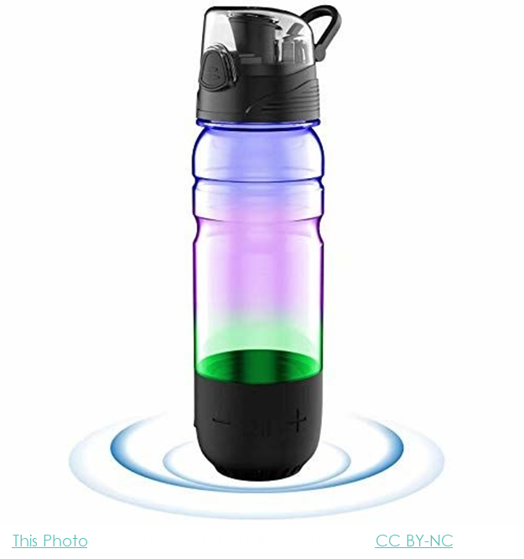
Smart Bottle
Presented By:Nityanshi Dubey

Slide 2
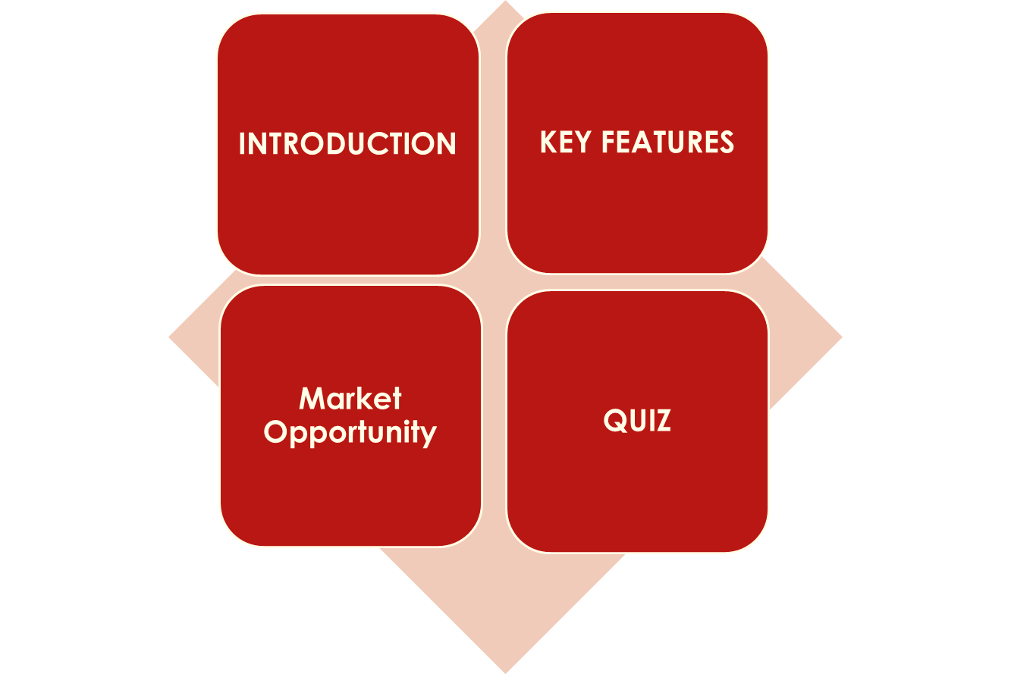
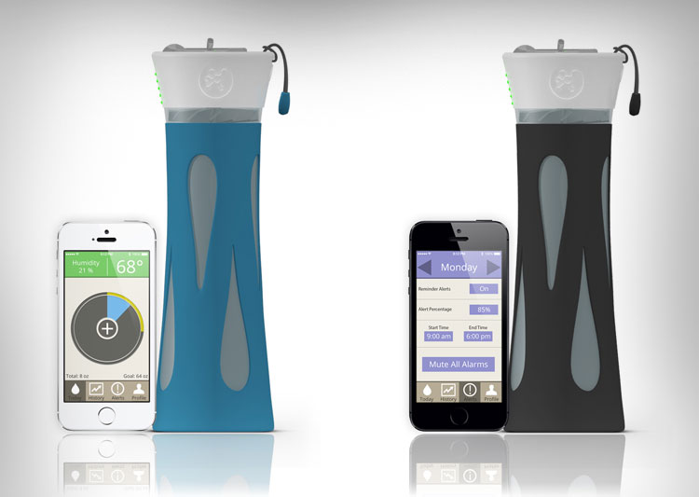
Content:

Slide 3
Introduction-:
A Smart Water Bottle is an innovative solution designed to help individuals monitor and optimize their daily water intake. It incorporates advanced technology to promote healthier hydration habits, combining convenience, functionality, and sustainability.
A Smart Water Bottle is more than just a container for liquids—it is a high-tech gadget equipped with sensors, connectivity features, and user-friendly interfaces. It integrates seamlessly into your daily life to ensure you stay hydrated effectively and efficiently.

Slide 4
KEY FEATURES:-
Sends reminders to drink water through vibration, LED alerts, or app notifications. Personalized schedules based on your activity level, weather conditions, and age.
Smart Notifications:
Health Monitoring: Measures beverage composition, including electrolytes or pH levels.
Suggests hydration adjustments for optimal health.
Battery Life and Charging:
Long-lasting rechargeable battery for continuous use. Convenient USB or wireless charging options.
Eco-Friendly Materials: Constructed with sustainable, BPA-free, and durable materials.
Reduces the need for single-use plastic bottles.

Slide 5
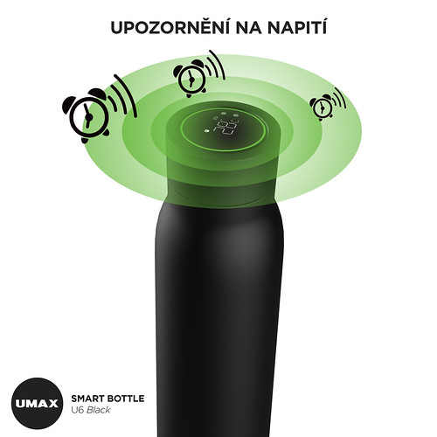
Market Opportunity:-
Growing Health Awareness:
Increasing focus on hydration for improved health and productivity. Rising demand for health-tracking devices.
Smart Device Boom:
Expanding IoT market with high adoption of wearable and connected tech.
Broad Audience Appeal:
Ideal for fitness enthusiasts, professionals, parents, elderly, and eco-conscious consumers.
Revenue Potential:
Global market projected to reach $50+ billion by 2030, with a CAGR of ~10-15%.

Slide 7

1.What is the primary purpose of a Smart Bottle?
a) To store water b) To track hydration and remind you to drink water c) To heat beverages d) To reduce water waste
Answer: b) To track hydration and remind you to drink water

